Slide 1
Sensing Plant and Soil Temperatures in Snowy Alpine Environments: Part II
Martha Apple¹, James Gallagher², Kevin Negus³, Jamison Ehlers³
¹Biological Sciences, ³Electrical Engineering, Montana Technological University, ²OPeNDAP, Inc.

Slide 2
Alpine Plant Ecology and Environmental Sensing
Plant functional traits vary with position on periglacial patterned ground and near snowfields in the alpine tundra.
Periglacial patterned ground provides a mosaic of microhabitats.
Environmental sensing links plant functional traits with environmental signals.
FLIR (Forward Looking Infrared) images detect temperatures of plants and of patterned ground and snowfields.
We installed an array of soil temperature sensors but can only retrieve data at the sites.
Our alpine tundra sites are in the wilderness, have harsh winters, and are accessible only in late summer.
Research could be scaled up with wilderness-ready soil moisture sensors and with remote and year-round access to data.
We are developing a sensor system to send soil data to the internet via Iridium satellites.

Slide 3
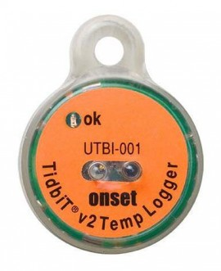
At Goat Flat, Pintler Mountains, SW Montana, 2845 m, 46°02’47.03” N, 113°16’41.68”W, we:
Surveyed the distribution of plant species and functional traits
Installed 36 ONSET Hobo TidbitV2 #UTBI-001 Temperature Sensors at 4 sites, 5-10 cm in soil,
(18 sensors in center of polygons or brown stripes, 18 on edge of polygons or green stripes)
Brown Centers of Polygons: Rhizomes, taproots, + herbaceous plants
Astragalus sp., Carex, Sedum lanceolatum, Gentiana calycosa
Green Edges of Polygons: Herbaceous plants, dwarf shrubs, + coniferous trees
Dryas octopetala, Salix arctica, Phyllodoce empetriformis,

Slide 4
Center of Polygon
Edge of Polygon

Slide 5
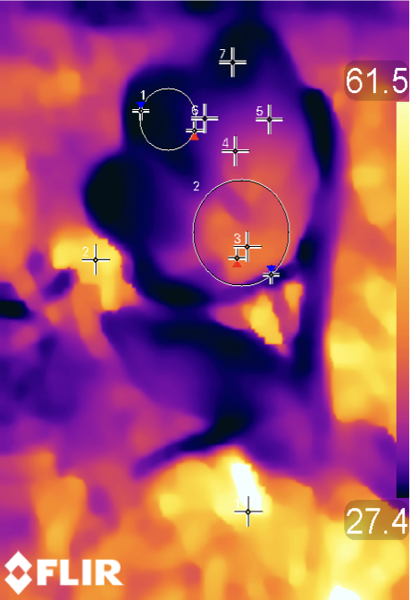
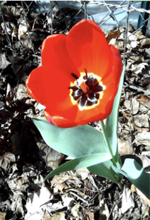

MEASUREMENTS (°C)
Spot 1 58.2
Spot 2 53.3
Spot 3 41.6
Spot 4 35.1
Spot 5 32.5
Spot 6 29.8
Spot 7 27.7
Circle 1
Max. 29.4 Min. 27.3 Avg. 28.1
Circle 2 Max. 42.0 Min. 28.6 Avg. 38.2

Slide 6
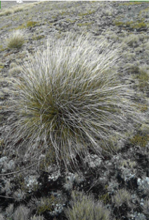
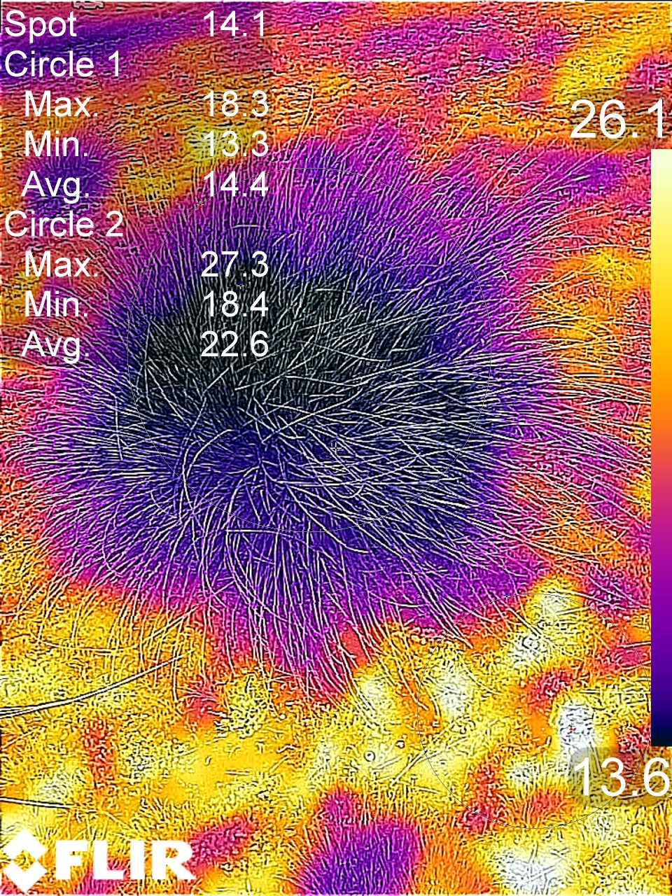
Tussocks at the
GLORIA Alpine site
on Mt. Pisa
in New Zealand
are cooler
than the surrounding
plants and ground.
Pacific Ocean
Beach Sand

Slide 7
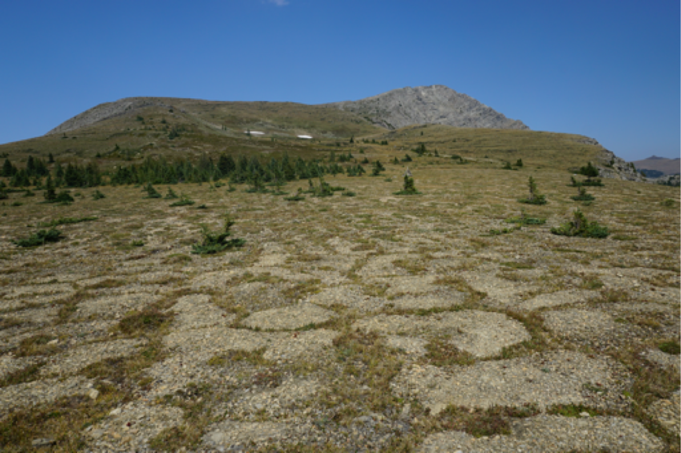
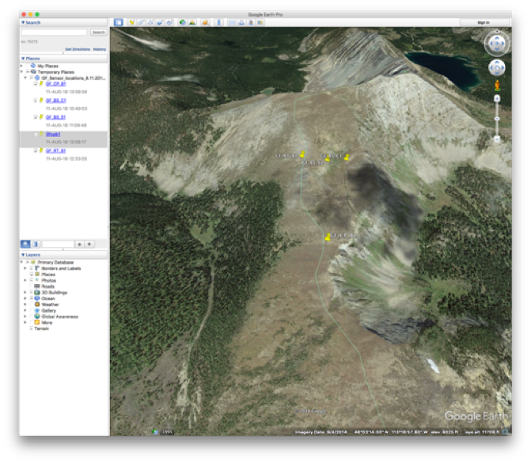
With the ESIP lab program:
We are developing prototype soil moisture sensors for year-round use on the alpine tundra
Sensors will be underground and not susceptible to wind and animal damage
Sensor data should be remotely accessible throughout the year
Data will be gathered from ~10 locations at the study site
Data will be sent to a data store accessible via the Internet.

Slide 8
Current sensor design
Hardware simplification – Use RocketScream boards for all nodes
Integrated real time clock, faster processor, more memory, LoRa, battery power features and low power modes
Simpler than discrete components – decrease development time
Build significant local storage into node
Using ruggedized SD memory cards; vast storage potential
Adopt a mesh network architecture
Each leaf node will send its own information, listen/store from nearby nodes and selectively re-broadcast information from nearby nodes
More robust than a star architecture
See poster: High Altitude Soil Testing: Increasing Accessibility of Data from Remote Locations, Jamison Ehlers; Martha Apple; Kevin Negus

Slide 9
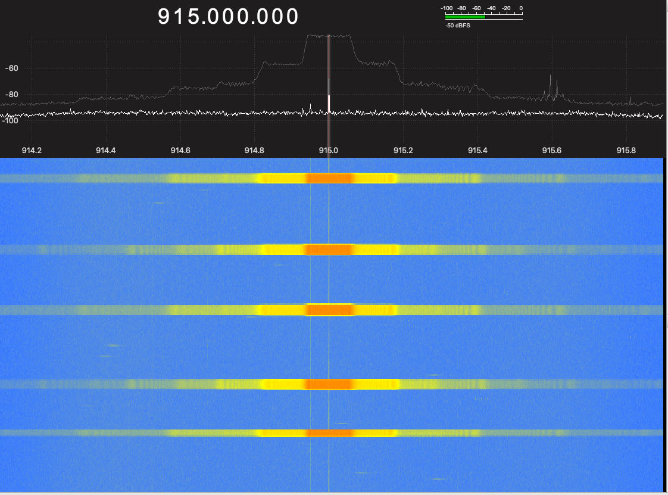
Experiments with LoRa
Tests run using moderate settings
Bandwidth (BW) = 'Chips' per symbol
Coding rate (CR) = Extra information sent for error correction
Spreading factor (SF) = Number of chips used for each bit (R_{c} = R_{b} * 2^{SF})
Our tests:
BW = 125kHz, CR =1, SF = 7
Transmission power = 13 dBm
Message length 57 bytes (93 bytes in transmission frame)
Time on air: 107.78 ms

Slide 10
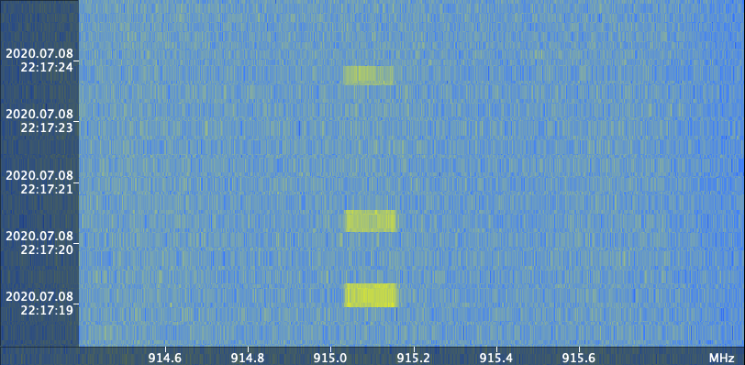
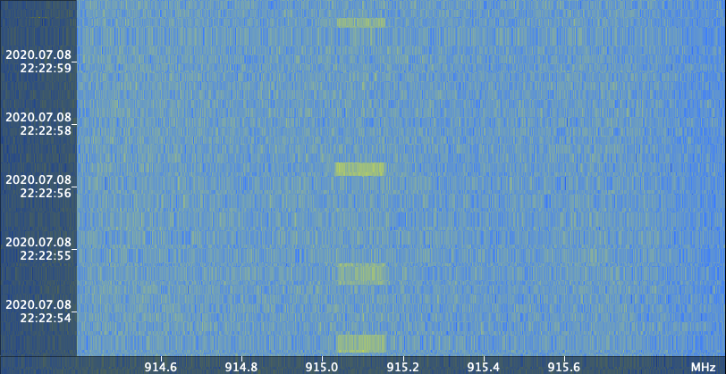
Field Experiments with LoRa
Nodes separated from receiver by ~200 and ~300 ft
Used BW = 125 kHz, CR = 1, SF = 7
Transmission power = 13 dBm
Signal strength
Line of sight: -95 to -120 dBm
Ground Obstacle: -102 to -120 dBm
Line of sight
Ground obstacle

Slide 11
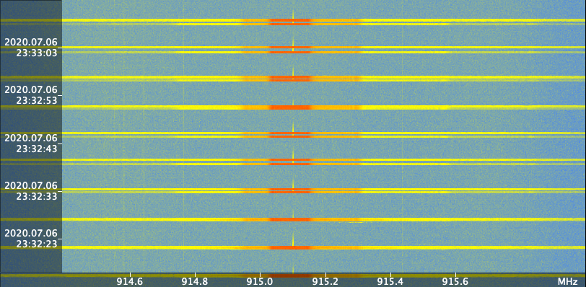
LoRa Channel Activity Detection
Adding Channel Activity Detection reduced collisions from unsynchronized nodes
#1 - Nodes started at the same time - Transmissions collide
#2 - CAD added - one node waits for the other to complete transmission
It's not perfect...
#3 - CAD may fail
Tests indicate it provides a benefit
3
2
1

Slide 12
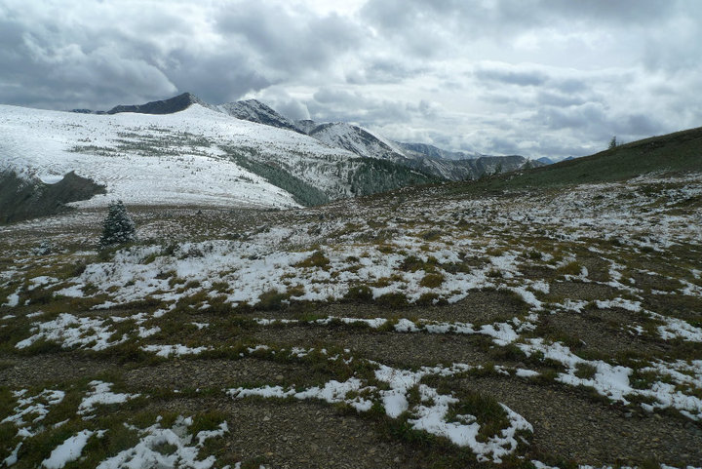
We acknowledge SURF (Summer Undergraduate Research Fellowship) and the ESIP Lab Program.

